Slide 1
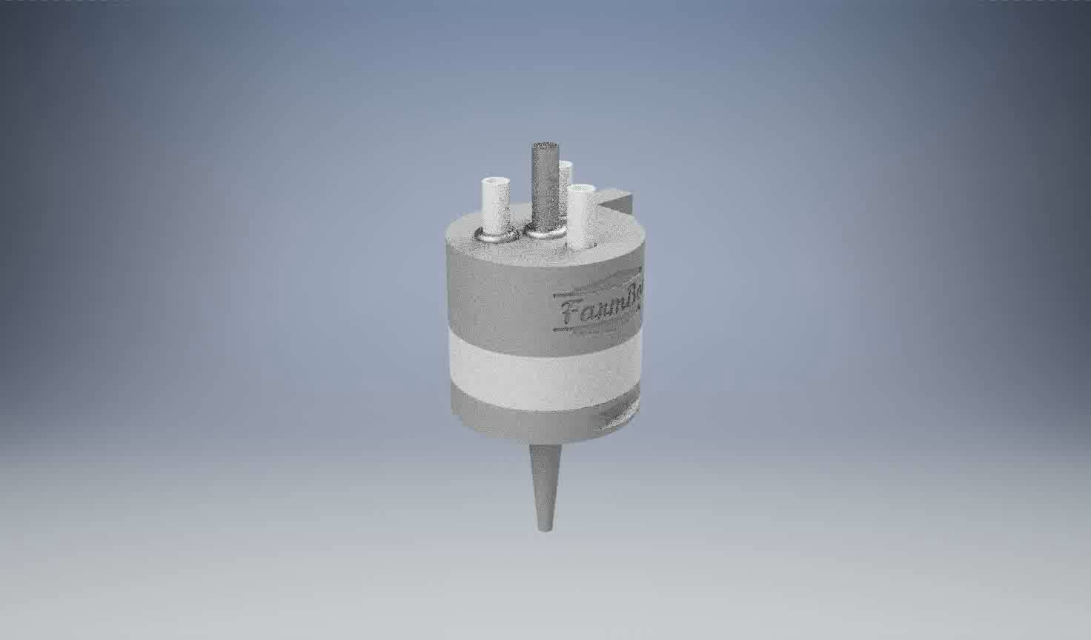
Universal Tool Mount
Tools
Watering Tool
Weeder Assembly
Seeder
Soil Sensor
Custom Tool Possibility
Working Principle
Magnet Rings
Conductive screws

Slide 2
Movement of UTM

Slide 3
Objectives
Mechanical movement system with working software interface.
Water and vacuum system integration
Led system integration

